Slide 1
Web apps development | Mobile apps development | Desktop apps development
IT Outsourcing | IT Consulting | System Integration Services | Business Process Modeling
www.appcro.com
„We provide Cutting edge software for global markets & Award-winning Cloud platforms.”

Slide 2
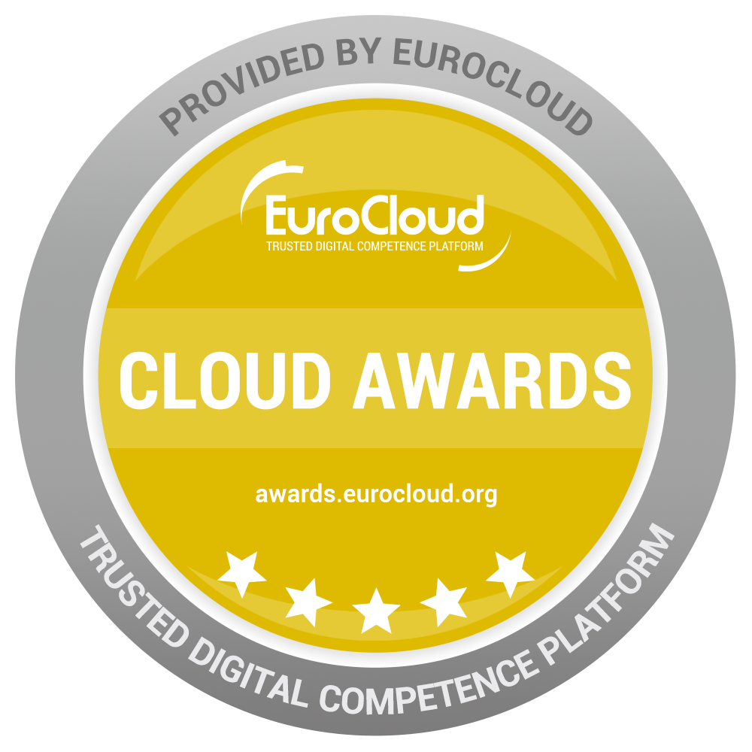
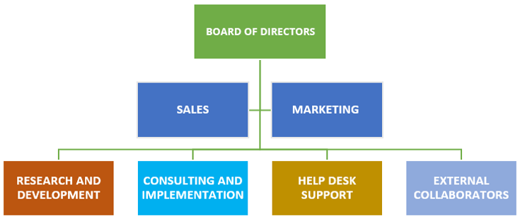
Company Info
„25+ Software Solutions – 3 ISO Certifications – 2 Software Awards – 3 Companies.”
APPCRO GROUP:
1. UK – APPCRO Ltd.
2. USA – APPCRO Inc.
3. HR – APPCRO d.o.o.
„Worldwide Internal Stuff & External Collaborators: 100+ persons & 50+ partners.”

Slide 3
Company References

Slide 4
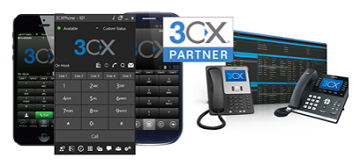
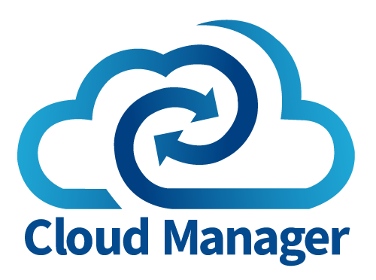
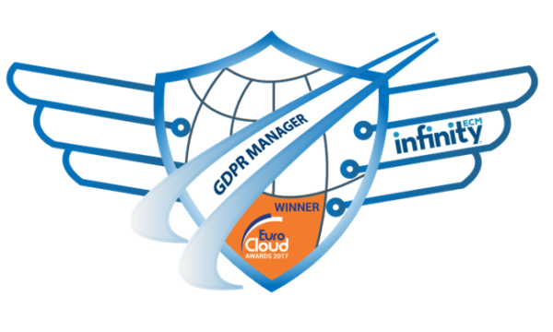
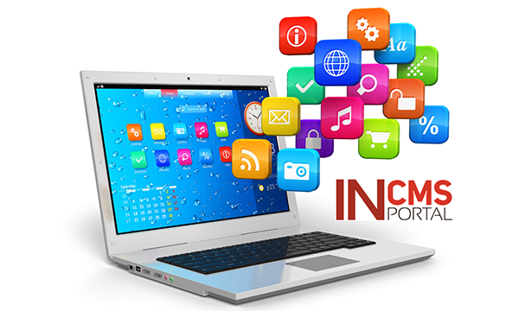
Products & Solutions

Slide 5
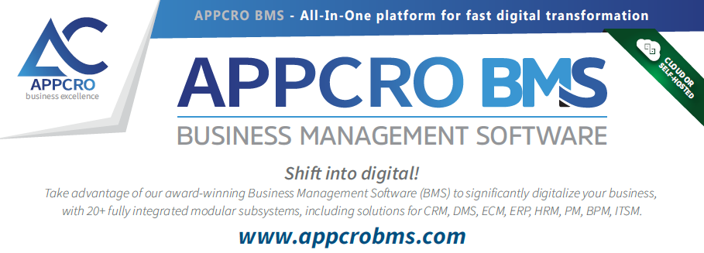
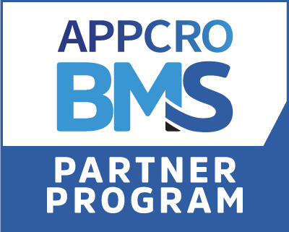
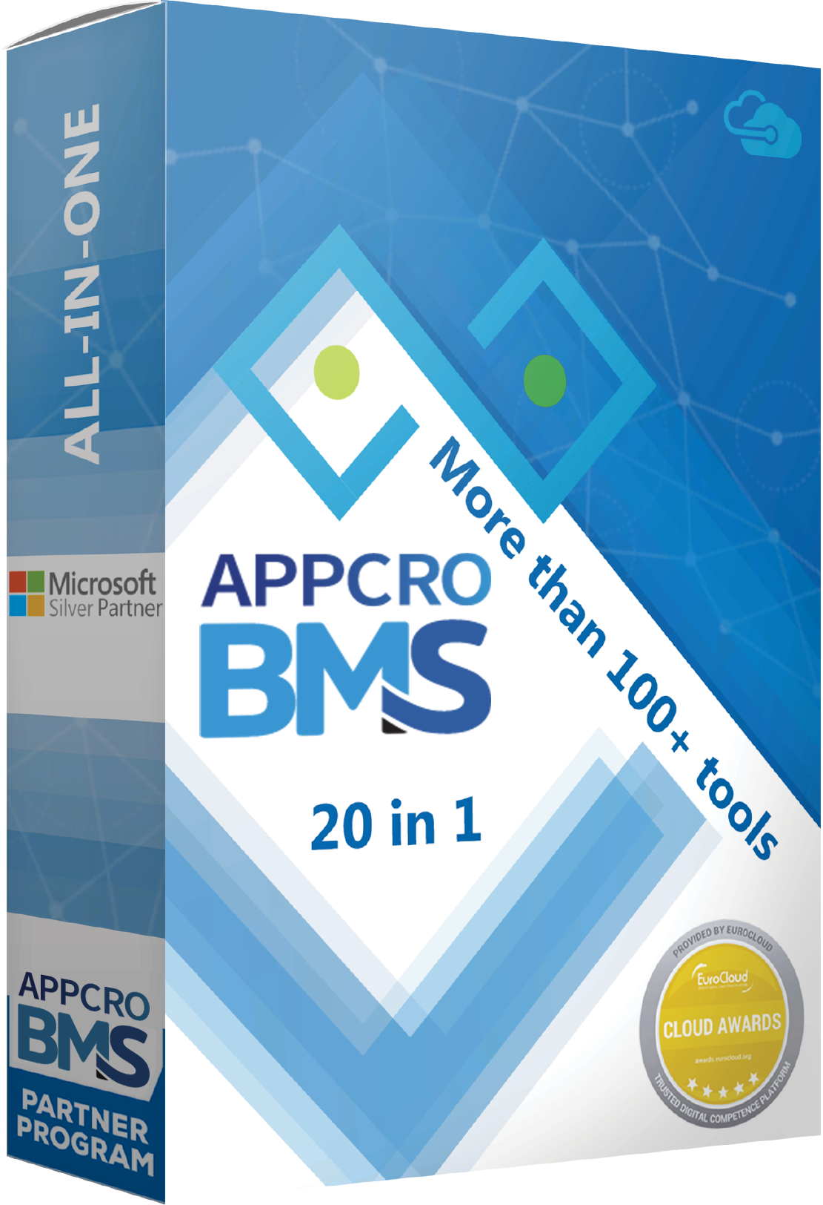
Introduction to: APPCRO BMS platform

Slide 7
APPCRO BMS platform – Main software advantages:
Out of the box Cloud SaaS or On-Premise (local) 23 in 1 Business Management Software (BMS).
Multifunctional and fully modular web based platform solution with 23 sub-systems & 250+ modules.
Consolidates, optimizes, reduces (number & cost) and improve company software infrastructure.
Multilingual (16+ languages) & globally available over Cloud SaaS or official APPCRO local partners.
Supports, improve & extend more than 50 business processes in every kind of global organization.
A fully responsive software solution (easy to use on desktop, tablet and smartphone mobile devices).
Easy integrations & extensions for different software products (ERP, HRM, PLM, WMS, CRM).
Different platform versions are suitable for any kind of small, middle and big global organizations.
The platform includes these solutions: CRM, DMS, ECM, RMS, ERP, BPM, CMS, ITSM, EAM, KMS, GRC, PM.
Flexible enterprise architecture based on Web API services with the ability of plug-in modules and apps.
Multi-company support & multi-org model (one system can be used for many group-related companies).
Up to 30% increase in work productivity (better task management, collaboration, and work records, verifications & document approvals, digitization of documents & templates, portals, easy online availability).
Microsoft based solution (On-prem requires MS Win App. Server, MS SQL Express, no extra MS CAL licenses).
Fast and easy digital process transformation (fast 1-3 months implementation and simple API integration).

Slide 8
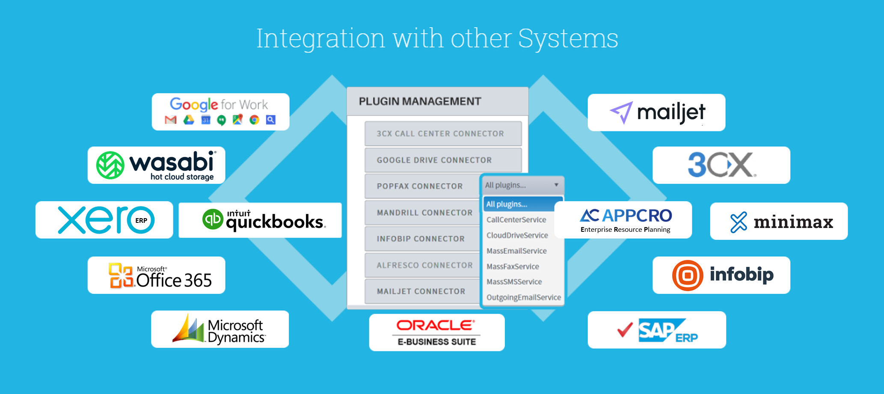

Slide 9
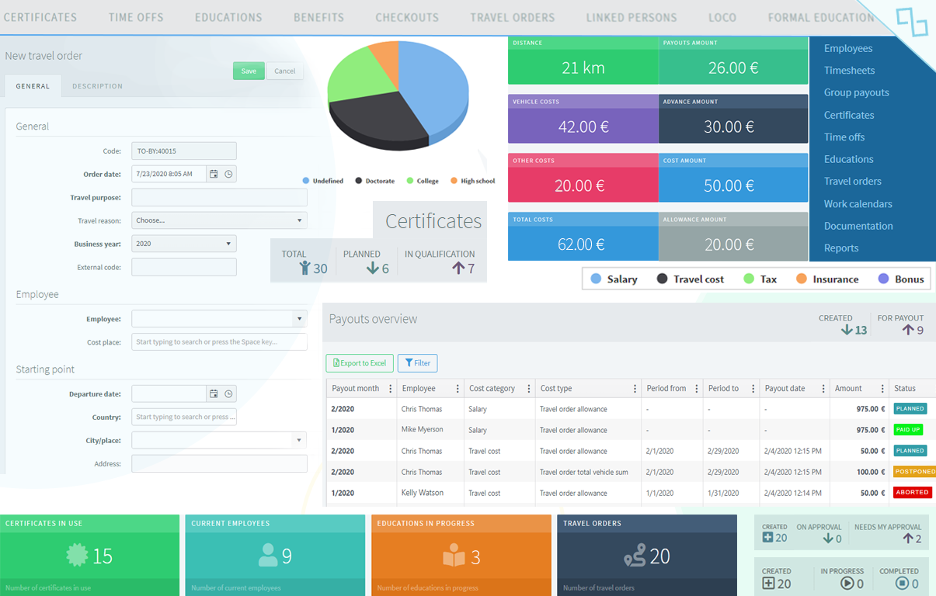
APPCRO BMS platform → HRM User interface example:

Slide 10
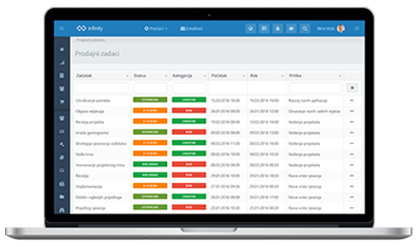
APPCRO BMS (ex Infinity ECM) live demo:
→ Click for video introduction ←

Slide 11
www.appcrobms.com
www.appcro.com
USA – UK – CROATIA
info@appcro.com

